Slide 2
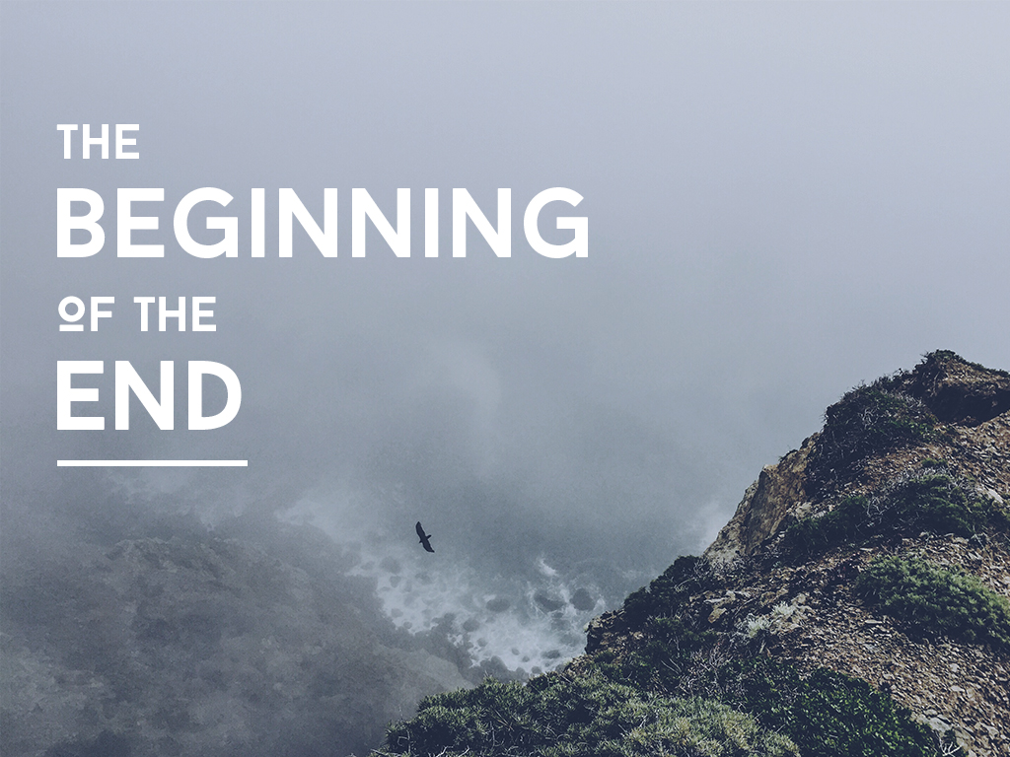

Slide 3
2 KINGS 17
13 The Lord warned Israel and Judah through all his prophets and seers: “Turn from your evil ways. Observe my commands and decrees, in accordance with the entire Law that I commanded your ancestors to obey
and that I delivered to you through
my servants the prophets.”

Slide 4
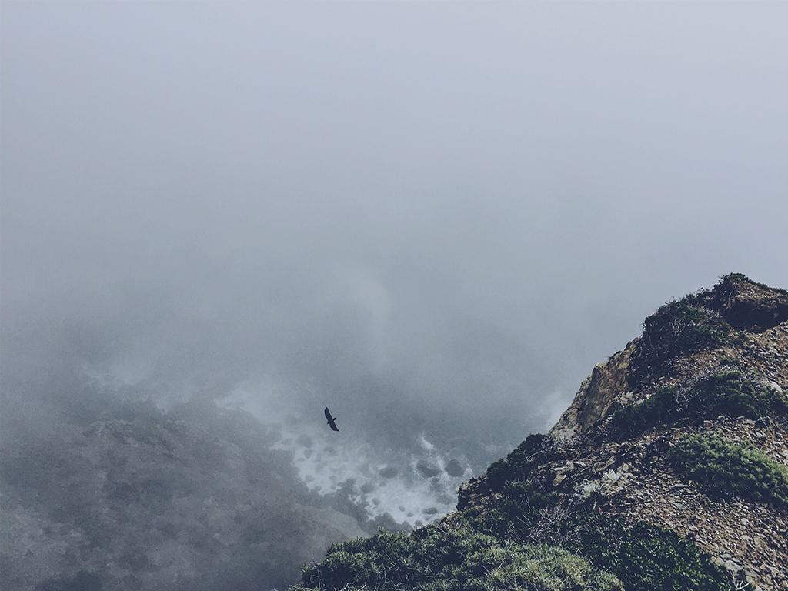
2 KINGS 17
14 But they would not listen and were as stiff-necked as their ancestors, who did not trust in the Lord their God. 15 They rejected his decrees and the covenant he had made with their ancestors and the statutes he had warned them to keep. They followed worthless idols and themselves became worthless. They imitated the nations around them although the Lord had ordered them, “Do not do as they do.”

Slide 5
2 KINGS 17
18 So the Lord was very angry with Israel and removed them from his presence. Only the tribe of Judah was left,

Slide 6
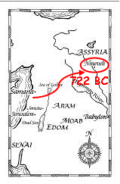
THE BEGINNING OF THE END

Slide 7
2 KINGS 18
17 The king of Assyria sent his supreme commander, his chief officer and his field commander with a large army, from Lachish to King Hezekiah at Jerusalem. They came up to Jerusalem and stopped at the aqueduct of the Upper Pool, on the road to the Washerman’s Field. 18 They called for the king; and Eliakim son of Hilkiah the palace administrator, Shebna the secretary, and Joah son of Asaph the recorder went out to them.

Slide 8
2 KINGS 18
19 The field commander said to them, “Tell Hezekiah:
“‘This is what the great king, the king of Assyria, says: On what are you basing this confidence of yours? 20 You say you have the counsel and the might for war—but you speak only empty words. On whom are you depending, that you rebel against me?

Slide 9
2 KINGS 18
21 Look, I know you are depending on Egypt, that splintered reed of a staff, which pierces the hand of anyone who leans on it! Such is Pharaoh king of Egypt to all who depend on him. 22 But if you say to me, “We are depending on the Lord our God”—isn’t he the one whose high places and altars Hezekiah removed, saying to Judah and Jerusalem, “You must worship before this altar in Jerusalem”?

Slide 10
2 KINGS 18
23 “‘Come now, make a bargain with my master, the king of Assyria: I will give you two thousand horses—if you can put riders on them! 24 How can you repulse one officer of the least of my master’s officials, even though you are depending on Egypt for chariots and horsemen[e]? 25 Furthermore, have I come to attack and destroy this place without word from the Lord? The Lord himself told me to march against this country and destroy it.’”

Slide 11
2 KINGS 18
28 Then the commander stood and called out in Hebrew, “Hear the word of the great king, the king of Assyria! 29 This is what the king says: Do not let Hezekiah deceive you. He cannot deliver you from my hand. 30 Do not let Hezekiah persuade you to trust in the Lord when he says, ‘The Lord will surely deliver us; this city will not be given into the hand of the king of Assyria.’

Slide 12
2 KINGS 18
31 “Do not listen to Hezekiah. This is what the king of Assyria says: Make peace with me and come out to me. Then each of you will eat fruit from your own vine and fig tree and drink water from your own cistern, 32 until I come and take you to a land like your own—a land of grain and new wine, a land of bread and vineyards, a land of olive trees and honey. Choose life and not death!

Slide 13
2 KINGS 18
“Do not listen to Hezekiah, for he is misleading you when he says, ‘The Lord will deliver us.’ 33 Has the god of any nation ever delivered his land from the hand of the king of Assyria? 34 Where are the gods of Hamath and Arpad? Where are the gods of Sepharvaim, Hena and Ivvah? Have they rescued Samaria from my hand? 35 Who of all the gods of these countries has been able to save his land from me? How then can the Lord deliver Jerusalem from my hand?”

Slide 14
THE BEGINNING OF THE END
-How do you run a tiny nation when the greatest army in the world is camped on your northern border?

Slide 15
THE BEGINNING OF THE END
-How do you run your tiny life when great challenges are camped on your northern border?

Slide 16
2 KINGS 19
Hezekiah’s Prayer
14 Hezekiah received the letter from the messengers and read it. Then he went up to the temple of the Lord and spread it out before the Lord. 15 And Hezekiah prayed to the Lord: “Lord, the God of Israel, enthroned between the cherubim, you alone are God over all the kingdoms of the earth. You have made heaven and earth. 16 Give ear, Lord, and hear; open your eyes, Lord, and see; listen to the words Sennacherib has sent to ridicule the living God.

Slide 17
2 KINGS 19
17 “It is true, Lord, that the Assyrian kings have laid waste these nations and their lands. 18 They have thrown their gods into the fire and destroyed them, for they were not gods but only wood and stone, fashioned by human hands. 19 Now, Lord our God, deliver us from his hand, so that all the kingdoms of the earth may know that you alone, Lord, are God.”

Slide 18
2 KINGS 19
Then Isaiah Prophesies
32 “Therefore this is what the Lord says concerning the king of Assyria:
“‘He will not enter this city
or shoot an arrow here.
He will not come before it with shield
or build a siege ramp against it.

Slide 19
2 KINGS 19
33 By the way that he came he will return;
he will not enter this city,
declares the Lord.
34 I will defend this city and save it,
for my sake and for the sake of David my servant.’”

Slide 20
2 KINGS 19
35 That night the angel of the Lord went out and put to death a hundred and eighty-five thousand in the Assyrian camp. When the people got up the next morning—there were all the dead bodies! 36 So Sennacherib king of Assyria broke camp and withdrew.

Slide 21
SO WHAT?
How does this story, God’s story, intersect my story?

Slide 22
SO WHAT?
-How do you run your tiny life when great challenges are camped on your northern border?

Slide 23
ISAIAH 53
Who has believed our message
and to whom has the arm of the Lord been revealed?
2 He grew up before him like a tender shoot,
and like a root out of dry ground.
He had no beauty or majesty to attract us to him,
nothing in his appearance that we should desire him.

Slide 24
ISAIAH 53
3 He was despised and rejected by mankind,
a man of suffering, and familiar with pain.
Like one from whom people hide their faces
he was despised, and we held him in low esteem.

Slide 25
ISAIAH 53
4 Surely he took up our pain
and bore our suffering,
yet we considered him punished by God,
stricken by him, and afflicted.

Slide 26
ISAIAH 53
5 But he was pierced for our transgressions,
he was crushed for our iniquities;
the punishment that brought us peace was on him,
and by his wounds we are healed.

Slide 27
ISAIAH 53
6 We all, like sheep, have gone astray,
each of us has turned to our own way;
and the Lord has laid on him
the iniquity of us all.

Slide 28
ISAIAH 53
7 He was oppressed and afflicted,
yet he did not open his mouth;
he was led like a lamb to the slaughter,
and as a sheep before its shearers is silent,
so he did not open his mouth.

Slide 29
ISAIAH 53
10 Yet it was the Lord’s will to crush him and cause him to suffer,
and though the Lord makes[c] his life an offering for sin,
he will see his offspring and prolong his days,
and the will of the Lord will prosper in his hand.

Slide 30
ISAIAH 53
11 After he has suffered,
he will see the light of life[d] and be satisfied[e];
by his knowledge[f] my righteous servant will justify many,
and he will bear their iniquities.

